Slide 1
Docker, Alembic, FastAPI

Slide 2
Docker
Docker lets us package apps + its OS level environment into a reproducible box.
Those boxes are called images.
When you run an image you get a container.
A Dockerfile is a recipe for building images.

Slide 3
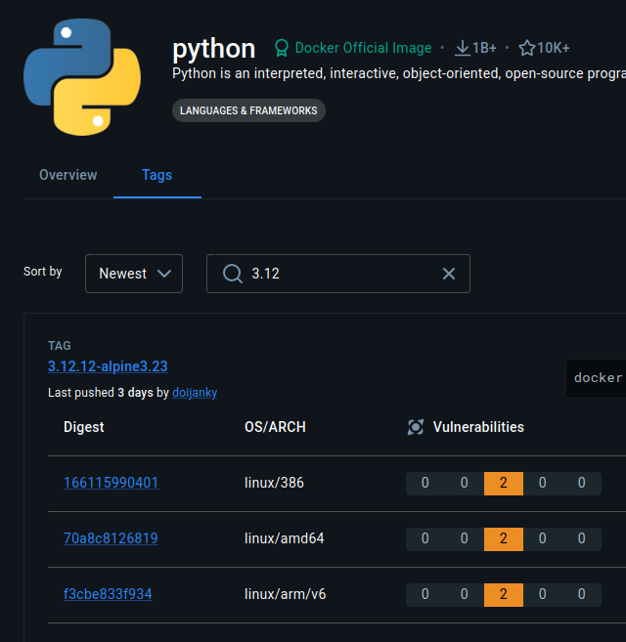
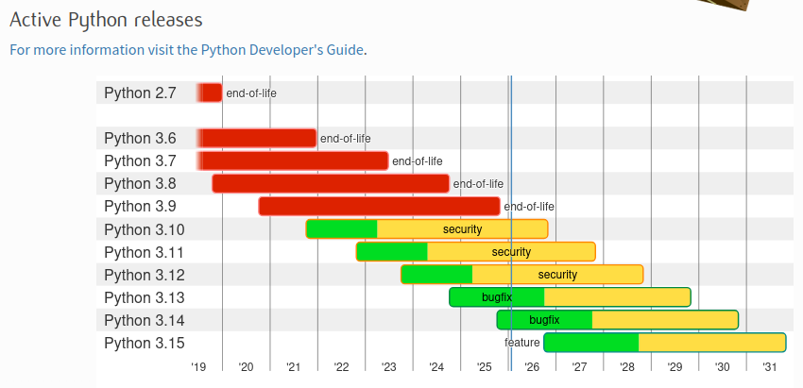
Consider your version
Docker Hub:
Python doesn’t do “LTS” releases.

Slide 4
Packages
Pyproject.toml new dependencies:
Sqlalchemy - maps python objects to database tables
Psycopg[binary] - driver to communicate with postressql
Sqlalchemy-utils - misc utilities
Alembic - managed db schema migrations
Python-dotenv - work with env variables
Fastapi - routes HTTP request to python code
Uvicorn - runs your web app and handles network traffic
Pydantic - provides serialization, DTO-like functionality
Run ‘poetry run alembic init alembic’ to generate folders/files for migrations

Slide 5
Single vs Multi-Stage Dockerfiles
Ships Everything: Only ships what’s needed:
FROM node:20
WORKDIR /app
COPY . .
RUN npm install && npm run build
CMD ["npm", "start"]
FROM node:20 AS builder
WORKDIR /app
COPY . .
RUN npm install && npm run build
FROM node:20-slim
WORKDIR /app
COPY --from=builder /app/dist ./dist
COPY --from=builder /app/node_modules ./node_modules
CMD ["node", "dist/index.js"]

Slide 6
Multi-Stage Image - Python App
FROM python:3.12-slim AS builder
WORKDIR /app
RUN apt-get update && apt-get install -y curl build-essential
RUN curl -sSL https://install.python-poetry.org | python3 -
ENV PATH="/root/.local/bin:$PATH"
COPY pyproject.toml poetry.lock /app/
RUN poetry config virtualenvs.create false
RUN poetry install --without dev --no-interaction --no-ansi
ENV PATH="/usr/local/bin:/root/.local/bin:$PATH"
COPY src /app/src
COPY src/repl.py /app/repl.py
COPY alembic.ini /app/alembic.ini
COPY alembic /app/alembic
Stage 1: builder
- Install system deps
- Install Poetry
- Set PATH to Poetry
- Turn off venv generation
- Install Python dependencies
- Add Alembic/uvicorn to PATH
- Copy source code/migrations

Slide 7
Multi-Stage Image - Python App
Stage 2: runtime
- We start with clean Python image - no curl, no build tools, no poetry install script, much smaller
- Copy only built artifacts
- Python Packages
- Source Code
- Poetry Binary
- Run the app
FROM python:3.12-slim
WORKDIR /app
COPY --from=builder /usr/local/lib/python3.12 /usr/local/lib/python3.12
COPY --from=builder /app /app
COPY --from=builder /usr/local/bin /usr/local/bin
ENV PYTHONUNBUFFERED=1
ENV PATH=”/usr/local/bin:/root/.local/bin:$PATH”
CMD ["uvicorn", "src.main:app", "--host", "0.0.0.0", "--port", "8000"]

Slide 8
Docker Compose
Docker Compose is a tool to define and run multi-container applications.
Spin up multiple containers at once
Define dependencies between services
Share environment variables
Manage volumes (persist data between restarts)

Slide 9
Super Ugly Docker Compose Slide :) sorry
services:
app:
build: .
container_name: myapp
env_file:
- .env
#volumes:
# - .:/app
depends_on:
db:
condition: service_healthy
ports:
- "8000:8000"
command: ["uvicorn", "src.main:app", "--host", "0.0.0.0", "--port", "8000"]
db:
image: postgres:15
container_name: mydb
env_file:
- .env
environment:
POSTGRES_USER: ${POSTGRES_USER}
POSTGRES_PASSWORD: ${POSTGRES_PASSWORD}
POSTGRES_DB: ${POSTGRES_DB}
ports:
- "5432:5432"
volumes:
- postgres_data:/var/lib/postgresql/data
healthcheck:
test: ["CMD-SHELL", "pg_isready -U ${POSTGRES_USER} -d ${POSTGRES_DB}"]
interval: 5s
timeout: 5s
retries: 5
volumes:
postgres_data:

Slide 10
First Migration / Build

Slide 11
Other Helpful Commands
alembic upgrade <revision> = Applies migrations up to the specified revision. head applies all pending migrations.
alembic downgrade <revision>
Rolls back migrations. Examples:
  alembic downgrade -1 → step back 1 revision
  alembic downgrade base → go back to the initial state
alembic history = Shows the list of all migrations and their revision IDs.
alembic current = Displays the current revision(s) applied to the database.
alembic heads = Shows the latest revision(s) in the migration tree (useful if you have multiple heads/branches).
alembic branches = Lists any branching points in your migration history.

